Slide 1
Vision in a Box: A twist on the Scavenger Hunt
Mrs. Nikkina McKnight
Teacher Cadet Instructor
Andrew Jackson High School
PSTA District 5

Slide 2
Purpose:
Guiding students into developing a vision that should help in:
setting direction
establishing priorities
clarifying goals

Slide 3
WHAT IS A VISION IN A BOX?
How did it come about?

Slide 4
Scavenger Hunt: Mandatory Lesson Objective: TSWBAT demonstrate personal qualities through a creative product and an oral presentation
Activities:
Give each Cadet a small bag
Tell students that as a homework assignment, they are to find words and pictures from magazines as well as small items that will decorate the outside of their bags and fit inside their bags to represent themselves in the following categories:
As a member of a personal family
As a member of the student body
As a member of an ethnic group (optional)
As a member of a gender (optional)
As a member of a larger community (e.g. church, sports, hobbies, volunteer activities)
As a Teacher Cadet
As a complete person
Theme 1: Experiencing Learning
Unit 1: Awareness and Reflection Page I-1-8
http://joom.ag/o2SX/p8

Slide 5
Vision in a Box! The Twist on the "Scavenger Hunt Objective: TSWBAT demonstrate personal qualities through a creative product and an oral presentation
Activities:
Each student will bring in a shoe box
Tell students that as a in class assignment, they are to find words and pictures from magazines and personal pictures that they will use to decorate the outside of their box to represent themselves in the following categories:
As a member of a personal family
As a member of the student body
As a member of an ethnic group (optional)
As a member of a gender (optional)
As a member of a larger community (e.g. church, sports, hobbies, volunteer activities)
As a Teacher Cadet
As a complete person
** follow directions from original lesson until it is time to create “THE VISION IN A BOX”**

Slide 6
Writing Component
First Paragraph: introduction about the activity, along with a statement about why it is important to have a VISION!!!
Second Paragraph: Brief description of the pictures, words and quotes that you put on the inside of your box that helped you bring your vision to life.
Third Paragraph: Summary about what you learned about your vision and why it is important to know one’s self.

Slide 7
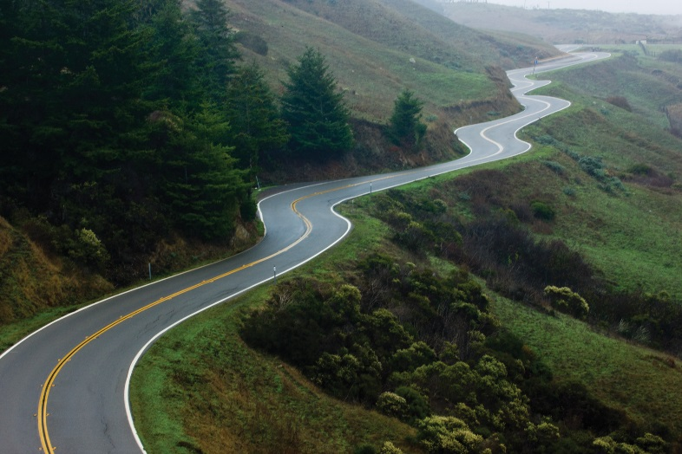
Vision in a Box! The Twist on the Scavenger Hunt
Begin by leading your students into a discussion on where they want to go in their future…asking...WHAT IS YOUR VISION FOR YOUR LIFE?!?!?!?
Ask them to visualize….where do you see yourself 5, 10, 15, 20 years down the road?

Slide 8
Supplies Needed:
Shoebox
Craft supplies (ie..ribbon, stickers, pompoms, glue, scissors…etc)
Construction paper
Happy, Fun, Music (optional ☺ )
*** If you would like make mini boxes like in the presentation, I ordered the boxes from Staples.com)

Slide 9
Create an “Ah Ha” moment!!!
Assure students that they can go anywhere and do anything if they set their minds to it.
Set the stage for them by telling your story….what was/is your vision?
Be TRANSPARENT with your students.

Slide 10
LET THE CREATING BEGIN
Have supplies that students can use. Magazines, markers, colored pencils, stickers, glue, ribbon, stickers….etc!
Allow them to bring in personal pictures, quotes, affirmations, but most importantly a DREAM, GOAL and a VISION.
Create an atmosphere of support, love, encouragement.
**REMEBER: the outside of the box will be used for the scavenger hunt. The inside of the box will be used to create the vision**

Slide 11
CHRISTINE’s STORY!!

Slide 12
LET THE FUN BEGIN!!
WHAT’S YOUR VISION?????
What’s in your box???

Slide 13
What lies behind us and what lies before us are small matters compared to what lies within us -Ralph Waldo Emerson

Slide 14
You want your students to stand in front of their destiny’s and dreams. Reminding them to never let anyone take their divine opportunities away from them.
Give them the opportunity to launch their platforms.
Speak your vision and believe in what the world need now more than ever….AN INDIVIDUAL WITH A VISION FOR TOMORROW!!!!

Slide 15
Nikkina.McKnight@lcsdmail.net
In Google Classroom: Vision in a box! 2016 Fall Renewal
Code: x57rjco

