Slide 1
Too Much Technology?
Kinesthetic Learning is for Big Kids, Too!
Elizabeth Martin Dawn Althen
Pinewood Prep Stall High School
Summerville, SC North Charleston, SC

Slide 2
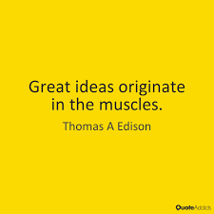

Slide 3
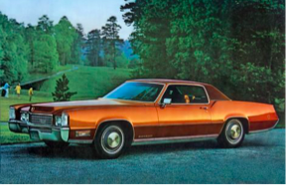
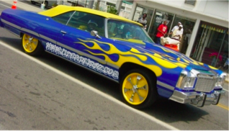
Making the Ordinary
a Little More Interesting

Slide 4
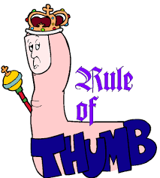
Planning
Directions
Learning Reflections
Real Life
Groups

Slide 5
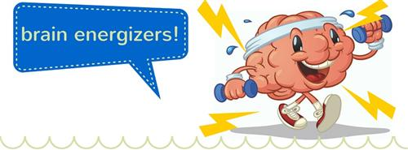
Motions
KFC
Picnic
Secret Code
Just Dance
Jumping Jacks
Simon Says

Slide 6
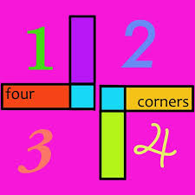
Specific Topics
Argumentative Topics- SA, A, SD, D
Group Discussions

Slide 7
Pass the Folder/ Stations

Slide 9
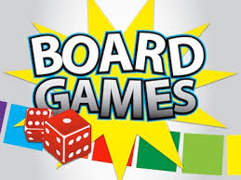
Student Created
board games/books
Books & Board Games

Slide 10
Scavenger Hunts & Shopping Sprees

Slide 11
Michaelangelo
Color by Vocabulary
Bio-Bodies

